Slide 1
Generative and Computational Models of Social Network Structure and Dynamics

Slide 2
Social network models
What is a model?
  Descriptive vs. generative models
What model social networks?
  Identify rules (logics) informing social processes that generate observed social networks
Dynamics (processes)
  Tie formation, evolution, decay
  Diffusion

Slide 3
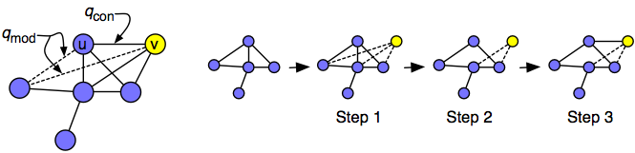
Social network models
General idea is “emergentist”:
  Global properties are generated from microlevel mechanisms
  Sometimes the local and global properties “match”
    E.g. choice homophily (rule) leads to global clustering by traits (macro property)

Slide 4
Social network models
General idea is “emergentist”:
  Global properties are generated from microlevel mechanisms
  Sometimes the global property is “surprising”:
    E.g. Preferential attachment (rule) leads to a small diameter (macro property)

Slide 5
Typology of social network models
Four main categories of models
  Nodal Attribute Models (NAMs)
    Probability of a link depends on attributes of the nodes
  Network Evolution Models (NEMs)
    The addition of new links depend on the local network structure
    Two main subcategories of NEMs
      Dynamical Models
      Growing Models

Slide 6
Typology of social network models
Four main categories of models
  Nodal Attribute Models (NAMs)
    Probability of a link depends on attributes of the nodes
  Two main subcategories of NEMs
    Dynamical Models
    Growing Models

Slide 7
Typology of social network models
Growing Models
Network Evolution Models
Social Network Models
Dynamical Models
Node Attribute Models
Exponential Random Graph Models*
*Not a real growth model

Slide 8
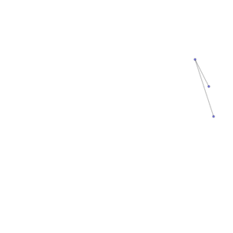
Network evolution models (NEMs)
More generally:
  Some network realization G is produced by an iterative process that starts from an initial network configuration G(t₀)
  Dynamical models begin a graph of a certain order and a given density
    Empty graph special case
  Growing models begin with a (small) seed network (sometimes a single node with “stubs”)
  The rules determine allowed transitions from one network G(t_{k−1}) to the next G(t_{k})
  The iterative process generates a single network realization G = G(t_{end}).

Slide 9
Network evolution models (NEMs)
The purpose of NEMs is to test the hypothesis that:
  Local network growth mechanisms
lead to:
  Specific global structures
    Clustering
    Given degree distribution
    Clustering
    Community structure
    Short diameter
    Degree correlations
    etc.

Slide 10
Network evolution models (NEMs)
The analyst must specify the stochastic rules by which the network evolves
  For instance, we may delete or add a subset of links at each time step
  We may “rewire” a set of existing links
There are two stopping criteria for NEMs:
  For a growing NEM, the algorithm finishes when a network reaches a predetermined size
  For a dynamical NEM the algorithm finishes when the network reaches a steady state

Slide 11
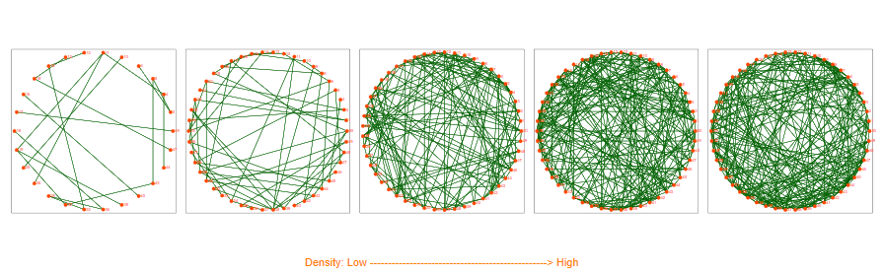
Typology of social network models
Dynamical Models:
  We add and/or remove ties on (starting) fixed set (N) of nodes:
    A fixed number of times M
    Until the structure of the network approaches equilibrium
      The Erdos-Renyi (1960) random graph model is a “dynamical model” by this definition

Slide 12
Typology of social network models
Dynamical Models:
  Erdos and Renyi (1960)
    Begin with a set of nodes N
    Pick two at random and link with probability p
    Repeat N(N-1) times

Slide 13
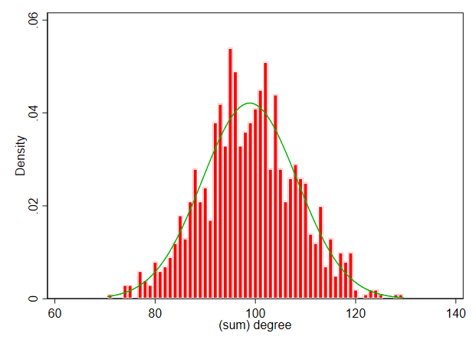
Typology of social network models
Dynamical Models:
  Erdos and Renyi (1960)
    Begin with a set of nodes N
    Pick two at random and link with probability p
    Repeat N(N-1) times
  Homogeneous (bell-shaped) distribution of node degrees
p = 0.05
N = 1000
p = 0.015
N = 500

Slide 14
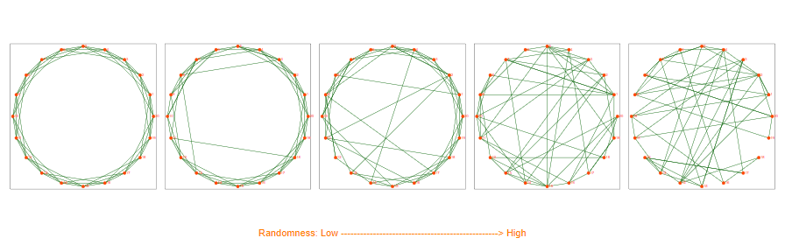
Typology of social network models
Dynamical Models:
  The Watt-Strogatz model is a dynamical model in this sense:
    Begin with a “regular” graph of order N
      In a regular graph each node is connected to k nearest nodes
    Pick a random edge with probability p
    Attach one end of the selected edge to a random node
    Repeat N times

Slide 15
Typology of social network models
Dynamical Models:
  The Watt-Strogatz model is a dynamical model in this sense:
    Begin with a “regular” graph of order N
      In a regular graph each node is connected to k nearest nodes
    Pick a random edge with probability p
    When p = 1 the Watt-strogatz model is an Erdos-Renyi graph with density determined by k (mean degree)

Slide 16
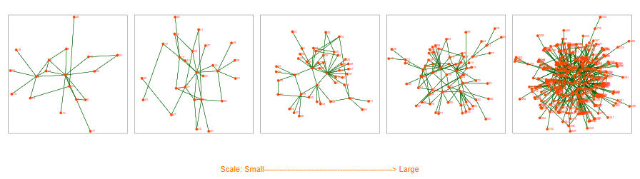
Typology of social network models
Growing Models:
  Nodes are added (and link according to some rule) until the network contains the desired number (N) of nodes
    The Barabasi-Albert preferential attachment model is a growing model by this definition

Slide 17
Typology of social network models
Growing Models:
  Barabasi and Albert (1999)
    Begin with two connected nodes
    New nodes connect to existing ones with p ~ k(i)
    Where k is the degree of node i
    Keep adding nodes until graph reaches size N

Slide 18
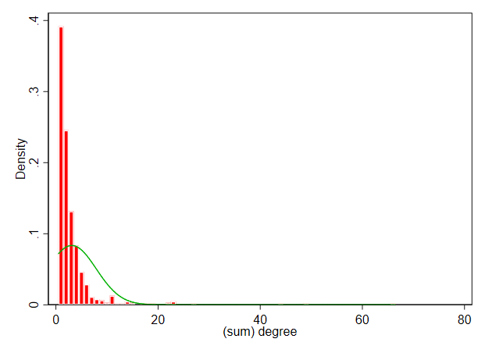
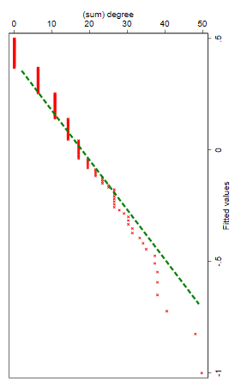
Typology of social network models
Growing Models:
  Barabasi and Albert (1999)
    Heterogeneous degree distribution
    Log-log plot can be fitted by a linear regression with beta = exponent of the power law p ∝ k^{beta}
N = 1000

Slide 19
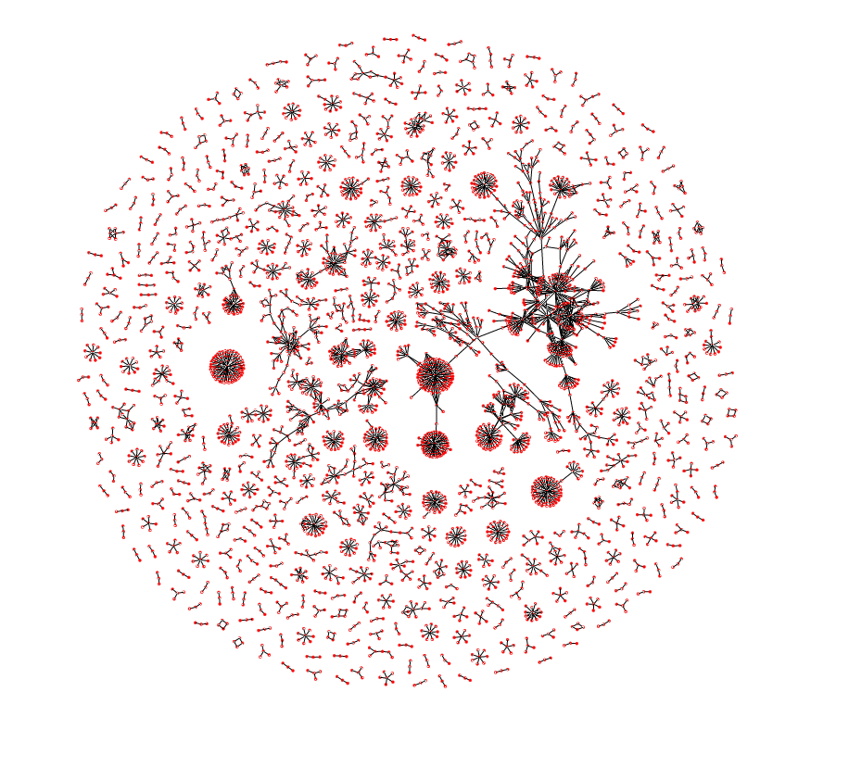
Nodal Attribute models (NAMs)
Nodal attribute models:
  The probability of an edge e_{ij} is a function of the attributes of i and j only
    e.g. p(e_{ij}) ~ d(i, j)
    Where d is distance in some socio-demographic dimension
  NAMs are thus models of the effect of homophily on network structure
  These are also referred to as spatial models

Slide 20
Nodal Attribute models (NAMs)
ERGMs (so-called "statistical" models) are not true models of network structure
  NEMs explicitly specify the rules of network evolution
  ERGMs tell us that some rule or mechanism is in operation but do not specify which one
  Mechanisms generating network structure are made explicit in NEMs but remain implicit in ERGMs

Slide 21
Example Dynamical NEMs
DEB (Davidsen et al., 2002)
Parameters | Mechanisms (number of nodes N fixed; repeat steps for (I) adding ties and (II) deleting ties until stationary distributions are reached)
2 free, N, p | (I) Select a node i randomly, and
 | (a) if i has fewer than two ties, introduce it to a random node,
 | (b) otherwise pick two neighbors of i and introduce them if they are not already acquainted.
 | (II) Select a random node and with prob. p remove all of its ties.

Slide 22
Example Dynamical NEMs
MVS(Marsili et al., 2004)
Parameters | Mechanisms (number of nodes N fixed; repeat steps for (I) adding ties and (II) deleting ties until stationary distributions are reached)
3 free, N, ξ, η | (I) Select a node i randomly, and
(λ=0.001) | (a) connect i to another random node with probability η
 | (b) Select a friend’s friend of i (by uniformly random search) with probability ξ and introduce i to it if not already acquainted.
 | (II) Select a random tie and delete it with probability λ.

Slide 23
Example Growing NEMs
TOSHK(Toivonen et al., 2006)
Parameters | Mechanism (repeat steps for (I) adding nodes and ties (II) adding ties only until network contains N nodes)
3 free, N, p, k (simplified) | (I) Add a new node i to the network, connecting it to one random initial contact with probability p, or two with probability 1−p.
 | (II) For each random initial contact j, draw a number msec of secondary connections from the distribution U[0,k] and connect i to msec neighbors of j if available.

Slide 24
Example Growing NEMs
Váz(Vázquez, 2003)
Parameters | Mechanism (repeat steps for (I) adding nodes and ties (II) adding ties only until network contains N nodes)
2 free N, u | (I) With probability 1−u, add a new node to the network, connecting it to a random node i. Potential edges are created between the newcomer n and the neighbors j of i (a potential edge means that n and j have a common neighbor, i, but no direct link between them).
 | (II) With probability u, convert one of such potential edges generated on any previous time step to an edge. Potential edges generated by converting an edge are ignored.

Slide 25
Example NAMs
BPDA(Boguñá et al., 2004)
Parameters | Mechanism
3 free, N, α, b | Distribute N nodes with uniform probability in a (one-dimensional) social space (a segment of length hmax). Link nodes with prob. p=1/(1+(d/b)α), where d is their distance in the social space. (hmax can be absorbed within b). If treated many-dimensionally, similarity along one of the social dimensions is sufficient for the nodes to be seen as similar.

Slide 26
Example NAMs
Parameters | Mechanism
3 free, N, α, b | Distribute N nodes with uniform probability in a (one-dimensional) social space (a segment of length hmax). Link nodes with prob. p=1/(1+(d/b)α), where d is their distance in the social space. (hmax can be absorbed within b). If treated many-dimensionally, similarity along one of the social dimensions is sufficient for the nodes to be seen as similar.

Slide 27
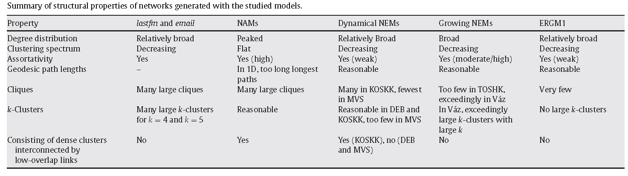
Model predictions against real world data
Most models reproduce average degree and size of largest component fairly well
  Simpler (one-parameter) models (DEB, Vaz) overstate clustering; other models did not have this problem

Slide 28
Model predictions against real world data
NAM (homophily-based) models do not generate realistic levels of clustering
  They also fail to produce heterogeneous (long-tailed) degree distributions
  They do generate clique and community structure

Slide 29
Model predictions against real world data
NEMs generate realistic level of degree-heterogeneity and clustering
  They also generate realistic levels of clustering and giant component size
  But assortativity falls short of empirical results
  Taking weights into account improves performance

Slide 30
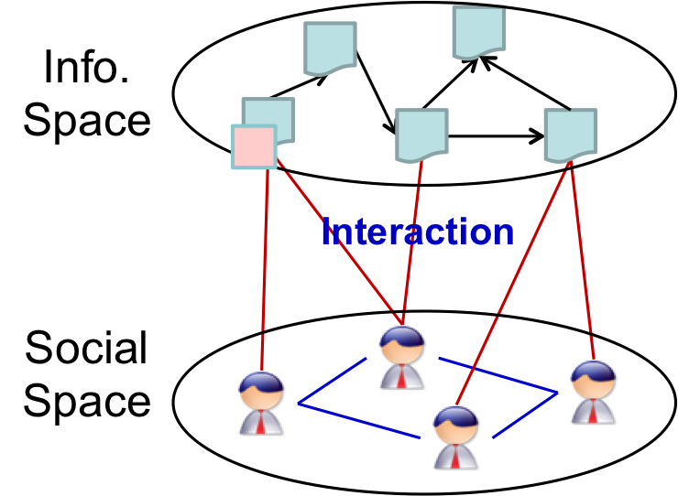
The constructural model
Key question:
  What accounts for the stability of social groups?
Key assumptions:
  Groups are defined by shared socio-cultural features
  Individuals acquire and communicate information
  Knowledge mediates interaction
    You interact with people who share cultural knowledge with you
  An individual’s behavior is a function of their current knowledge
  Groups form an endure via the exchange of knowledge across persons in interaction
  Group stability is at a maximum when no new knowledge enters the system
  Group stability is typically in flux as new knowledge (or individuals with different knowledge) enter the system

Slide 31
The constructural model
Elements of the constructural model:
  A set of persons (N)
  A “Culture” characterized by a set of “facts” or pieces of information (K)
    The number of facts determines the complexity of the culture
  A function (f) maps the set of facts to the set of persons such that:
    F_{ik}(t) = 1 if person i knows fact k at time t
    F_{ik}(t) = 0 if person i does not know fact k at time t
Stages of the model:
  Action/Interaction
    INT_{ij}(t) = 1 if i and j interact at time t
  Knowledge exchange
    u_{jk}(t) = 1 if i and j interact and j communicates fact k:
    C_{ijk}(t) = INT_{ij}(t) * u_{jk}(t):
      Interaction between i and j and j communicates fact k to i who “learns” it

Slide 32
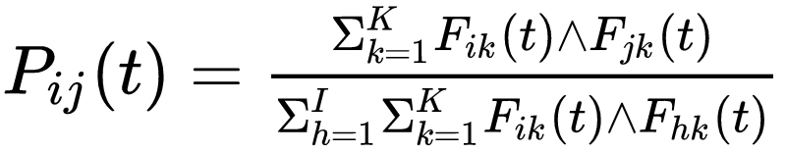
The constructural model
Elements of the constructural model:
  A set of persons (N)
  A “Culture” characterized by a set of “facts” or pieces of information (K)
    The number of facts determines the complexity of the culture
  A function (f) maps the set of facts to the set of persons such that:
    F_{ik}(t) = 1 if person i knows fact k at time t
    F_{ik}(t) = 0 if person i does not know fact k at time t
Stages of the model:
  Interaction homophily:
    At a subsequent time period the probability of future interaction is a function of the “relative cultural matching” (overlap in facts) between i and j:

Slide 33
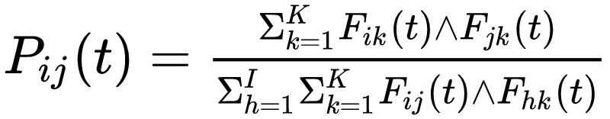
The constructural model
Elements of the constructural model:
  A set of persons (N)
  A “Culture” characterized by a set of “facts” or pieces of information (K)
    The number of facts determines the complexity of the culture
  A function (f) maps the set of facts to the set of persons such that:
    F_{ik}(t) = 1 if person i knows fact k at time t
    F_{ik}(t) = 0 if person i does not know fact k at time t
Stages of the model:
  Interaction homophily:
    At each time step a person i chooses a random interaction partner j with probability p_{ij} if that person has not been chosen yet:

Slide 34
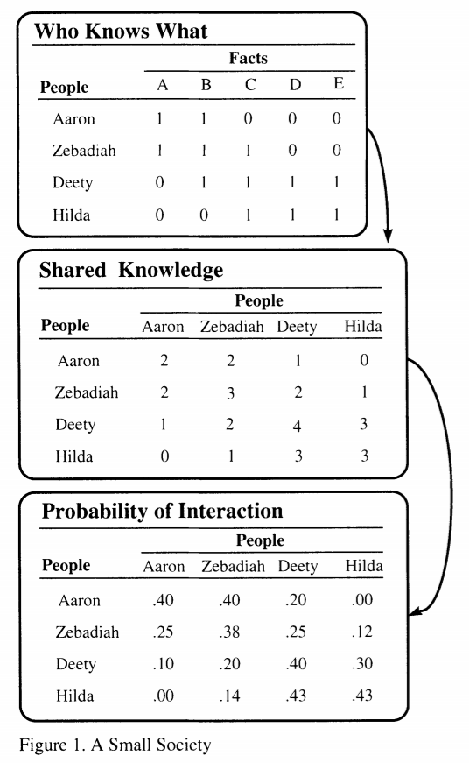
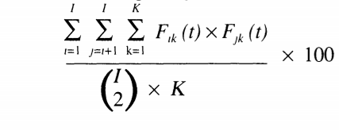
The constructural model
Constructural model can be thought as driven by the two mode person x cultural item network
  Share knowledge between people is the one-mode projection
  Leading to relative overlap probabilities of interaction
  The probability structure then determines who interacts with whom in the system
Outcomes
  Stability
    Perfect stability as a special case
  Time to stability
    Longer less stable
  Endurance
  Cultural Homogeneity:

